Slide 1
Field Application of a Model of Proton and Metal Mixture Bioavailability and Effects
Photo: VA Bell, Hinksey Lake 2023
E. Tipping¹, S. Lofts¹, W. Keller²
¹UK Centre for Ecology and Hydrology, Lancaster, UK
²Cooperative Freshwater Ecology Unit, Laurentian University, Sudbury, Ontario, P3E 2C6, Canada
stlo@ceh.ac.uk
Notes:
To add a title image, click on the icon in the space on the right. To change a title image, right click on the image and select Change picture.

Slide 2
Metal bioavailability & mixtures
pH
[DOC]
Metal bioavailability → toxicity
Bioavailability modelling
Field modelling of biodiversity
Hardness
Mixtures of metals
Acidification – a possible co-stressor
Reference biodiversity conditions

Slide 3
Bioavailability modelling and WHAM-F_{TOX}
Organism effect (single metal) ∝ occupancy of binding sites on organism by metal
BLM Binding at a specific ‘receptor’
WHAM-F_{TOX}
‘Metabolically active’ bound metal
Occupancy can be modelled using chemical equilibrium principles
Uses humic acid as surrogate for organism binding
Geochemical speciation model e.g. WHAM7
Binding model for organism
Fractional occupancy (θ)
Binding of multiple metals
Proton (H⁺) included as toxicant

Slide 4
WHAM-F_{TOX}: predicting impacts
Toxicity function - single species concentration addition model
Cation | n | α_{M,max,mean} | SE
H |  | (1.0)
Al | 7 | 2.6 | 0.0
Ni | 79 | 31.1 | 3.4
Cu | 1543 | 34.6 | 0.7
Zn | 118 | 17.0 | 1.3
Cd | 152 | 673 | 35
Hg | 5 | 621 | 347
Pb | 33 | 126 | 24
θ_{H,} θ_{M}
F_{tox,i} = θ_{H} + Σ α_{M,max,mean} × β_{i} × θ_{M}
intrinsic metal potency average across species, infinite time α_{M,max,mean}
Laboratory ecotoxicity test data
Species-specific sensitivity term
lognormally distributed
β_{i}
Fitting to field data
Tipping et al., Aquat. Toxicol 231, 105708 (2021). https://doi.org/10.1016/j.aquatox.2020.105708
Tipping et al., Aquat. Toxicol 212, 128-137 (2019). https://doi.org/10.1016/j.aquatox.2019.04.022
The value for H is set to 1.0;
n = number of data;
SE = standard error.

Slide 5
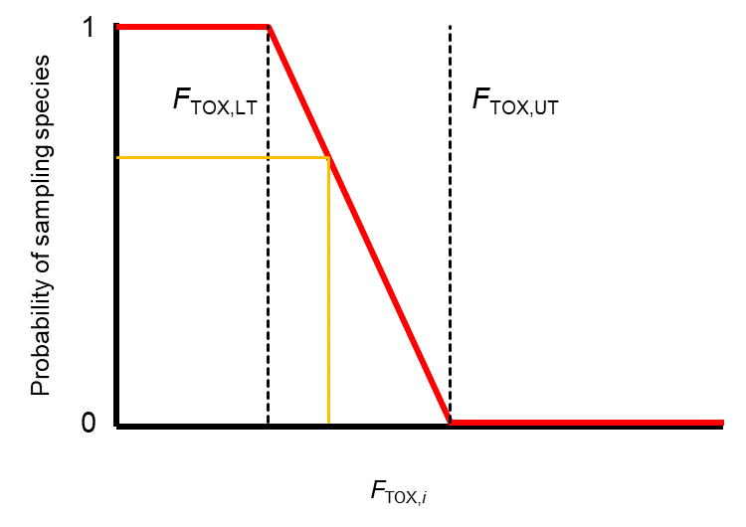
Relating toxicity to species response
Fixed relationship between F_{TOX,i} and effect (the probability of finding the species, Pr_{i})
if F_{TOX,i} < F_{TOX, LT} → Pr_{i} = 1 (species present)
if F_{TOX,i} > F_{TOX, UT} → Pr_{i} = 0 (species absent)
if F_{TOX, LT} < F_{TOX,i} < F_{TOX, UT} → Pr_{i} = 0 -1
Predicted number of species, n_{sp} = Σ Pr_{i}
F_{TOX, LT}, F_{TOX, UT} fixed, independent of species, obtained from laboratory data

Slide 6
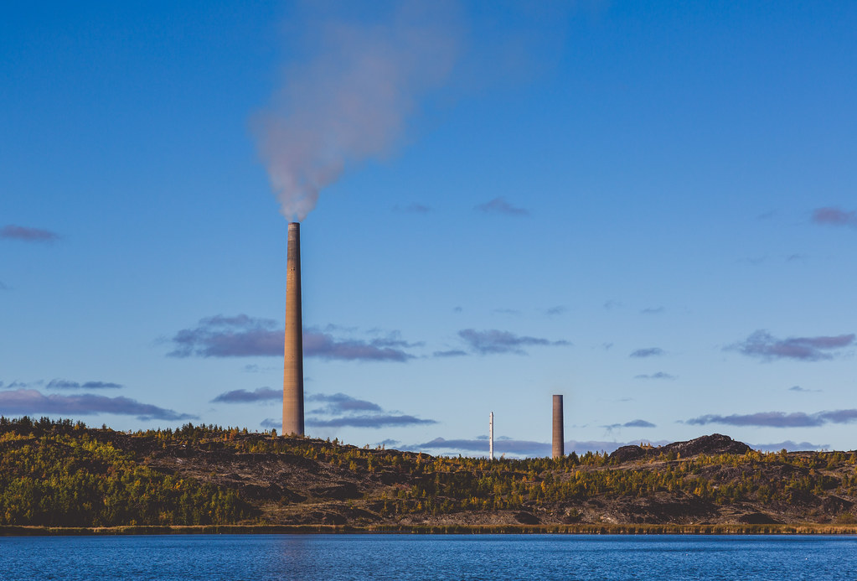
Sudbury Lakes
Map data: © OpenStreetMap contributors, SRTM | Map display: © OpenTopoMap (CC-BY-SA)

Slide 7
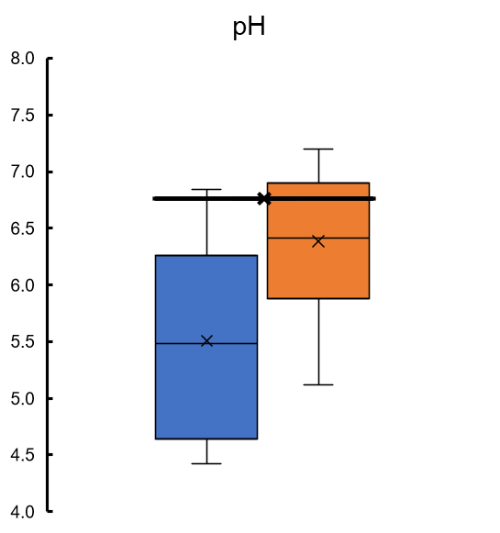
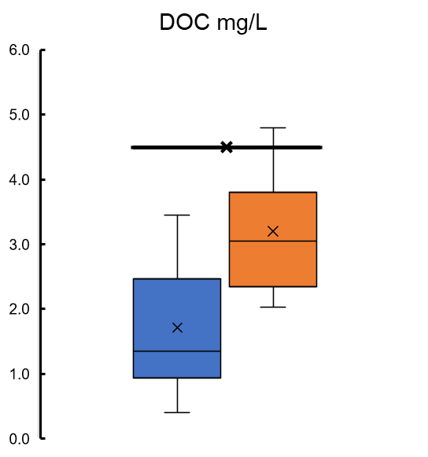
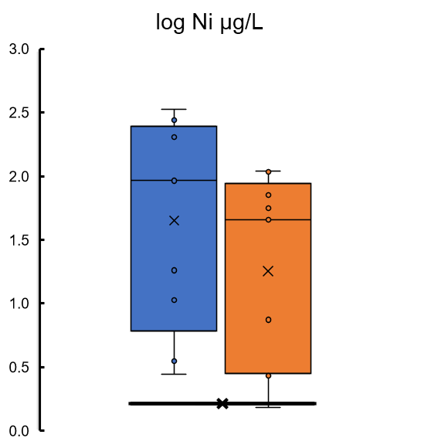
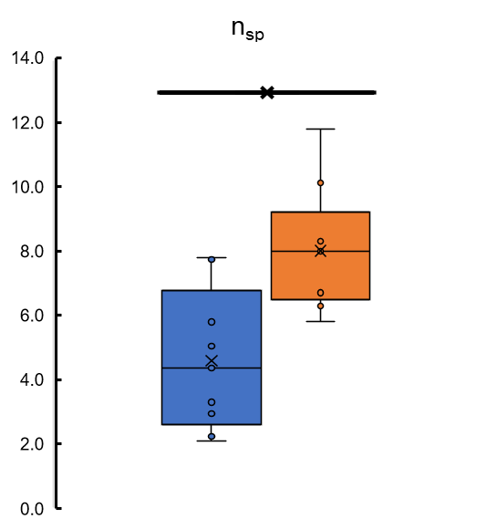
The field site chemistry
1980
2003
Nine lakes varying distances from smelters
+ reference (control) lakes distant from impacts
Smelter emissions peaked 1960s – reduced since by ~90%
Monitored since 1973 for chemistry and zooplankton
Some recovery seen
Modelling from 1973 to 2006
H, Al, Ni, Cu, Zn, Cd, Pb, Hg
n_{sp,ref} = 13

Slide 8
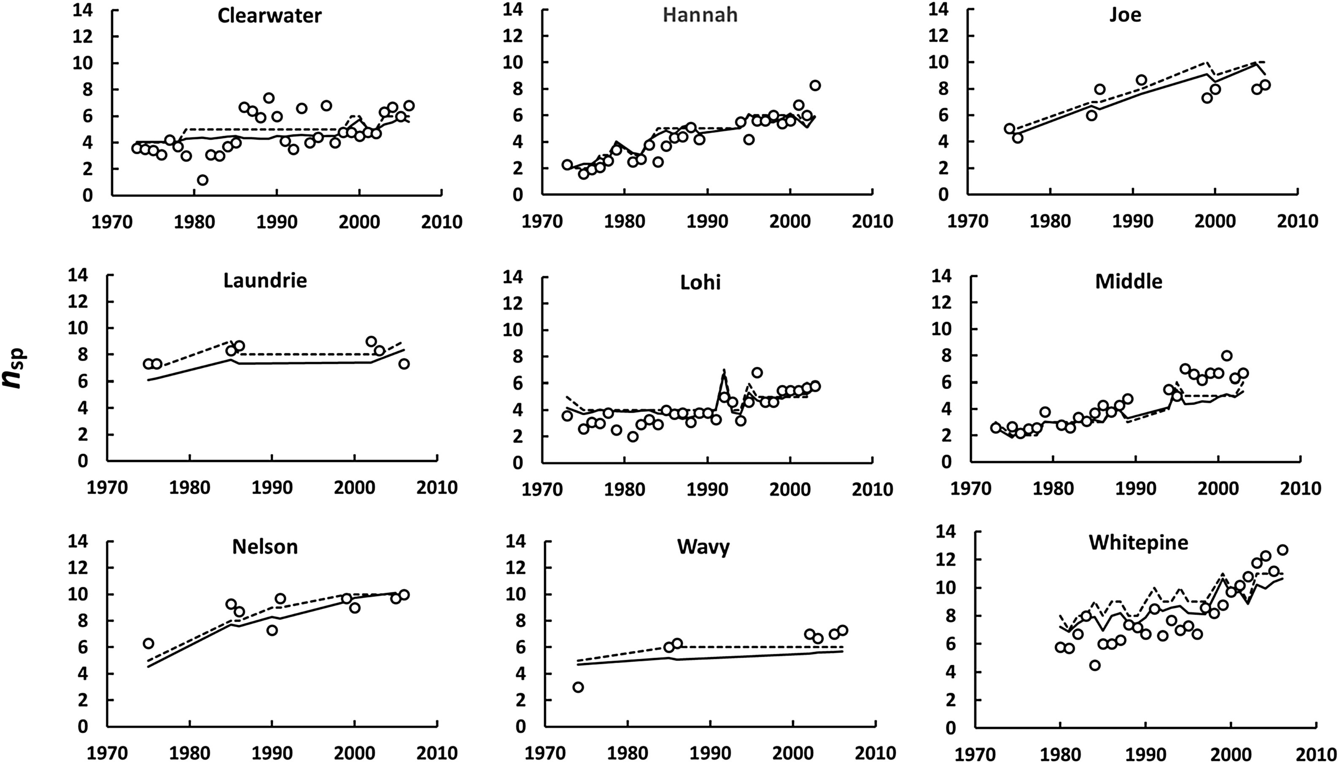
Results – Sudbury, Ontario
R² = 0.81
RMSD = 0.098 in log n_{sp}
Controls
Impacted lakes
Tipping et al., Aquat. Toxicol 231, 105708 (2021). https://doi.org/10.1016/j.aquatox.2020.105708

Slide 9
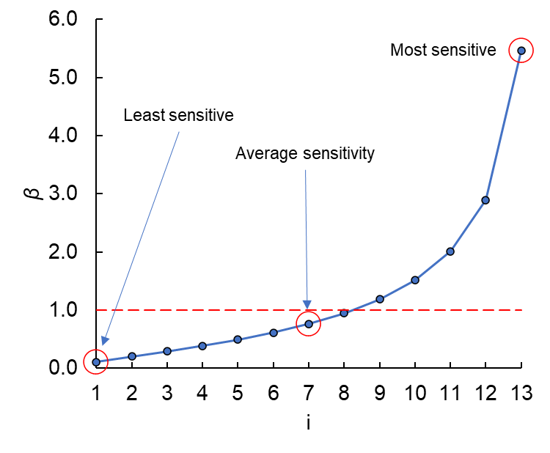
Sensitivity distribution
Mean log₁₀β = -0.117
SD log₁₀β = -0.483
β of ‘average’ species (i = 7) is 0.76

Slide 10
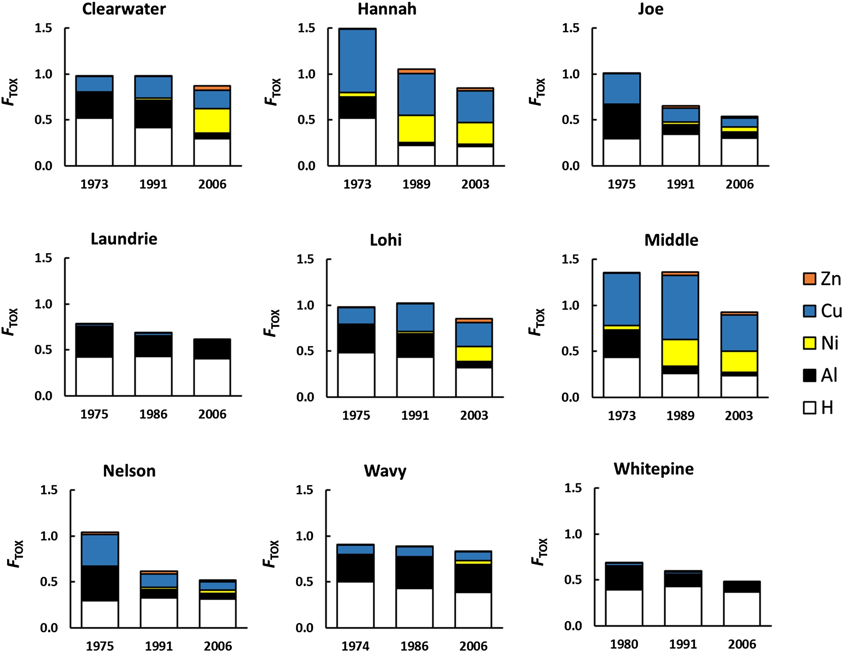
Results II – contributions to F_{TOX}
H, Al impacts ↓ as pH ↑
Relative role of metals and acidification is lake-specific
Metal contributions sometimes increase over time
?! – dissolved metal concentrations are decreasing
Lowest pH conditions suppress uptake of metals - H⁺ competition for organic binding sites

Slide 11
Conclusions
WHAM-F_{TOX} a very useful model for modelling complex mixture effects in the field – with fitting of a sensitivity distribution
Toxicity patterns results from a complicated set of interactions: pH ←→ metals, metals ←→ DOC, metals ←→ metals (competition & mixture effects)
WHAM-F_{TOX} predicts which metals are contributing the most to toxicity and how this changes as water composition does
Sensitivity distributions from lab ecotox data may make the model more predictive

Slide 12
Outlook
Tipping, E., Lofts, S., Stockdale, A. (2023). WHAM-FTOXβ – An aquatic toxicity model based on intrinsic metal toxic potency and intrinsic species sensitivity. Aquat. Toxicol. 258, 106503.
Further evaluation and use of literature ecotoxicity data
Distributions of species sensitivity (β values) from the literature
Potential for more general predictive application to the field
e.g. invertebrate richness in UK rivers

Slide 13
Thank you for listening
Special thanks to the staff of Cooperative Freshwater Ecology Unit, Laurentian University, for producing a remarkable long term dataset

