Slide 1
GNSS-Reflectometry at NOC:
Global ocean winds and sea-ice
Future mission concepts
Matthew Hammond¹, Giuseppe Foti¹,
Christine Gommenginger¹, Meric Srokosz¹,
Martin Unwin², Josep Rosello³
¹ National Oceanography Centre
² Surrey Satellite Technology Ltd (SSTL)
³ European Space Agency
EGU General Assembly, May 4-8^{th,} 2020

Slide 2
NOC GNSS-R Sea Ice Extent (GSID v1.0)
Agreement with ECMWF ERA-5: 98%
Notes:
Note: ERA5 only where collocated with NOC algorithm
Agreement so close that not clear which has the remaining error
n.b. using AGSP and hs filtering for sid
only selecting 1deg bins with more than 10 points

Slide 3
NOC GNSS-R Ocean winds (CBRE v1.0)
Agreement with ECMWF ERA-5: ~2m/s (RMSE)
Bias within ±0.5 m.s⁻¹ over 3.5 years
Both products available from www.merrbys.co.uk

Slide 4
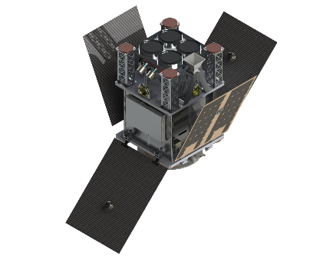
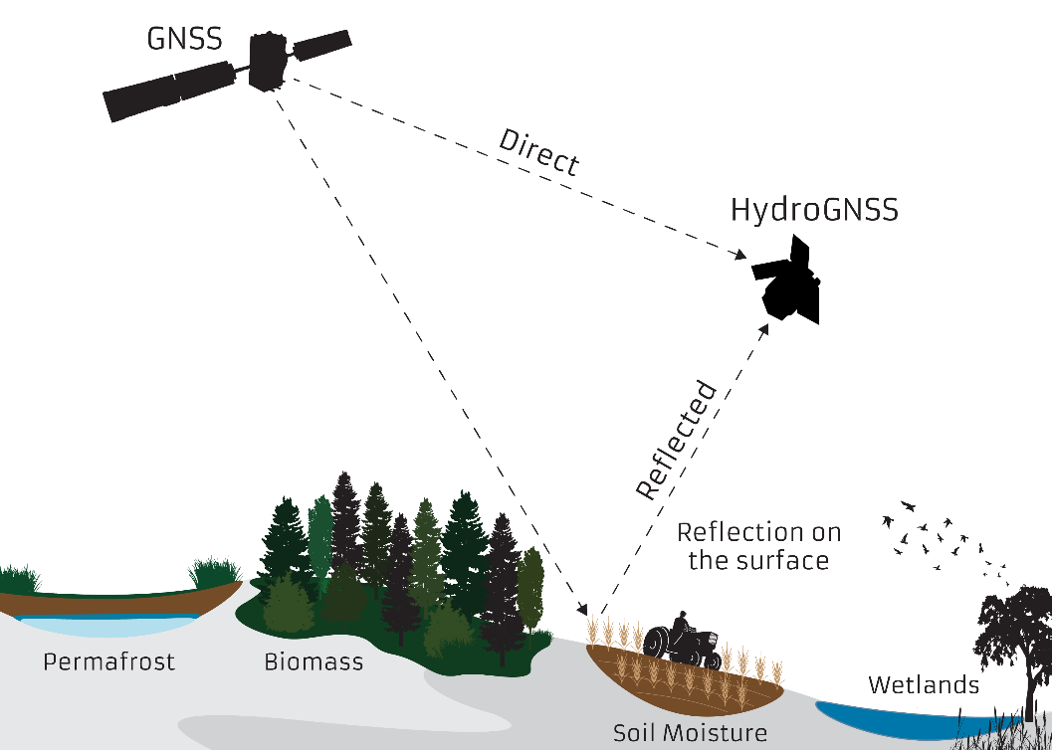
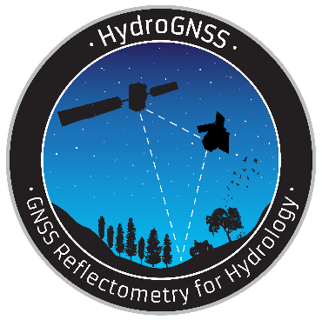
ESA HydroGNSS

