Slide 1
Emerging organic contaminants in groundwater in urban areas
Marianne Stuart, Debbie White, Kat Manamsa, Dan Lapworth, Peter Williams, James Sorensen
Emerging contaminants in water and soil, practical considerations: sampling, analysis and consequences. RSC, Sheffield, 4 March 2015

Slide 2
Emerging organic contaminants
Anthropogenic organic compounds and their transformation products
Emerge as result of:
  Changes in use/new manufactured chemicals
  Advances in analytical techniques
  Better monitoring
ECs in groundwater less well characterised than surface water, mainly due to lower concentrations
Most do not have quality standards for either surface or groundwater under the Drinking Water Directive or the WFD (Priority Substances Directive)
Groundwater thresholds can depend on relationship with surface water
Notes:
So the real definition of emerging is probably unregulated

Slide 3
Microorganic contaminants
Pesticides – parent compounds (e.g. metaldehyde),
metabolites
Pharmaceuticals – human, veterinary, illicit
“Life style” – nicotine, caffeine, sweeteners
Personal care – DEET, parabens, triclosan, musks, UV filters
Industrial additives and by-products – dioxanes, bisphenols, MTBE, phthalates, N- butyl benzene sulfonamide
Food additives – BHA, BHT
Water and wastewater treatment by-products – NDMA, THM
Flame/fire retardants – PBDE, alkyl phosphates, triazoles
Surfactants – alkyl ethoxylates, PFOS & PFOA
Hormones and sterols – estradiol, cholesterol
Notes:
DEET = N,N-diethyl-meta-toluamide
BHA = butylated hydroxyanisole
BHT = butylated hydroxytoluene
NDMA = N-nitrosodimethylamine
PDBE = polybrominated diphenyl ether
PFOS = perfluorooctanesulfonic acid
PFOA = perfluorooctanoic acid
Some of those in blue already hazardous substances e.g. DEHP, PFOS or nonyl phenol or have been withdrawn

Slide 4
Transformation products
May be more toxic, polar or persistent than the parent
For pesticides:
  Desethyl, desisopropyl - atrazine
  BAM from diclobenil
  AMPA from glyphosate
Common TPs>parent concentrations have been:
  Cotinine from nicotine
  Clofibric acid from clofibrate
  Nonyl phenol from NPE
Cannot be reliably predicted from surface environments data due to different geochemical conditions and long residence times
May have long arrival time due to thick unsaturated zone or low aquifer permeability
Stuart & Lapworth (2014)
Notes:
BAM=2,6-dichlorobenzamide
AMPA=aminomethylphosphonic acid
NPE=nonylphenol ethoxylates

Slide 5
New Priority Substances
2012 Commission proposal on priority substances (COM(2011)876)
New priority substances - aclonifen, bifenox, cybutryne, cypermethrin isomers, dichlorvos, dicofol, dioxins*, hexabromocyclododecane*, heptachlor/ heptachlor epoxide*, PFOS*, quinoxyfen*, terbutryne
  *designated as priority hazardous substances
Supplementary monitoring programmes for new substances to be in place by 2018
Revised EQS for existing substances – including anthracene, fluoranthene, naphthalene, PBDEs, trifluralin to be included in RBMPs by 2015
For surface water but also impact of groundwater
Notes:
COM (2011) 876
Article 16 of the Water Framework Directive (2000/60/EC) (WFD) sets out "Strategies against pollution of water", outlining the steps to be taken. The first step was to establish by way of Decision 2455/2001/EC a First list of priority substances to become Annex X of the WFD. These substances were selected from amongst those presenting a significant risk to or via the aquatic environment, using the approaches outlined in Article 16 of the WFD.
This first list was replaced by Annex II of the Directive on Environmental Quality Standards (Directive 2008/105/EC) (EQSD), also known as the Priority Substances Directive , which set environmental quality standards (EQS) for the substances in surface waters (river, lake, transitional and coastal) and confirmed their designation as priority or priority hazardous substances, the latter being a subset of particular concern. As required by the WFD and EQSD, the Commission subsequently reviewed the list and in 2012 it put forward a proposal for a Directive amending the WFD and the EQSD as regards priority substances.

Slide 6
Watch lists
Surface water
Priority Substances Directive amendment 2013/39/EU
Targeted EU-wide monitoring of substances of possible concern to support the prioritisation process in future reviews (10-14 in rolling programme)
First watch list -17α-ethinylestradiol,17β-estradiol, diclofenac
Groundwater
Draft COM Directive (Recital 4) amending Annex II of the GWD
Less developed than surface water
Increased availability of monitoring data to facilitate identification of substances
Notes:
PSD (EQS) 2008/105/EC - 2013 amendment 2013/39/EU
Aimed at targeted collection of monitoring data on substances that may pose a significant risk at EU level to or via the aquatic environment and for which monitoring data are insufficient, particularly emerging pollutants, to support risk assessment during future reviews of the priority substances list.
Draft COM directive amending Annex II of the GWD
Recital 4 – The need to obtain and respond to new information of other substances posing a potential risk should be acknowledged. Therefore a watch list for pollutants of groundwater should be established under the Common Implementation Strategy for the WFD to increase the availability of monitoring data on substances posing a risk or potential risk to bodies of groundwater and thereby facilitate the identification of substances.
Although the EQS values (and Priority Subs) only apply to SW, they have to be considered in GW as achieving good GW chemical status requires that pollutants in GW are note leading to a failure of an SW EQS and hence the SW chemical /ecological status objectives.

Slide 7
Top 30 microorganics in Environment Agency groundwater screening data 1993-2012
By frequency of detection
Pesticides and metabolites
PAHs
"Emerging contaminants"
Chlorinated solvents and THMs
Other
Notes:
Show how ECs are up there with the priority substances
Explain colours and graph axes
Caffeine, DEET and benzophenone right up there

Slide 8
Top 30 microorganics in Environment Agency groundwater screening data 1993-2012 by maximum concentration
Notes:
A very different picture with solvents predominating
BBSA, cholesterol and propyl paraben seen

Slide 9
Sources of ECs in urban groundwater
Notes:
My conceptual model

Slide 10
Microorganics in urban areas
Potential sources
  Sewer leakage
  Industrial effluent leakage
  Road runoff
  Old landfills
  Green space, and road and railway track maintenance
  Groundwater/surface water interaction
Types of compounds anticipated
  Pharmaceuticals and personal care products (PCP)
  Household compounds
  Industrial compounds
  Amenity pesticides
  PAH

Slide 11
Collecting groundwater samples for microorganics (MOs)
Boreholes or multi-level piezometers
  Measure water levels
  Collect discrete samples at different depths
Pump (peristaltic) or depth sampler made from inert materials
  Ptfe
  Stainless steel
Cleaned inert sample containers
Trained sample collection staff
  These are not generally made from inert materials
  Care in using PCPs, DEET or gloves
Specialised laboratory
  We have used the Environment Agency NLS

Slide 12
Characterised urban sites on the Sherwood Sandstone
Doncaster
  3 multilevel sites in suburbs – AISUWRS
  Profiles showed recharge from sewerage typically to depths of about 35 m bgl.
  Microbial indicators were found to depths of 60 m bgl
  Recharge estimates (mm/y) - foul sewer (22), storm water (12), mains water (22) = approx 30-40% of total recharge
Nottingham
  Multilevel sampler in area close to leaking sewage source
  Assessed range of “marker” species including B, THMs & d-limonene
  Sewage derived bacteria and viruses found to significant depths

Slide 13
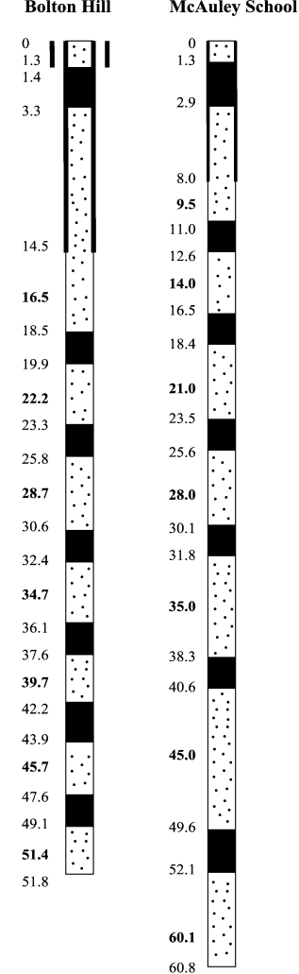

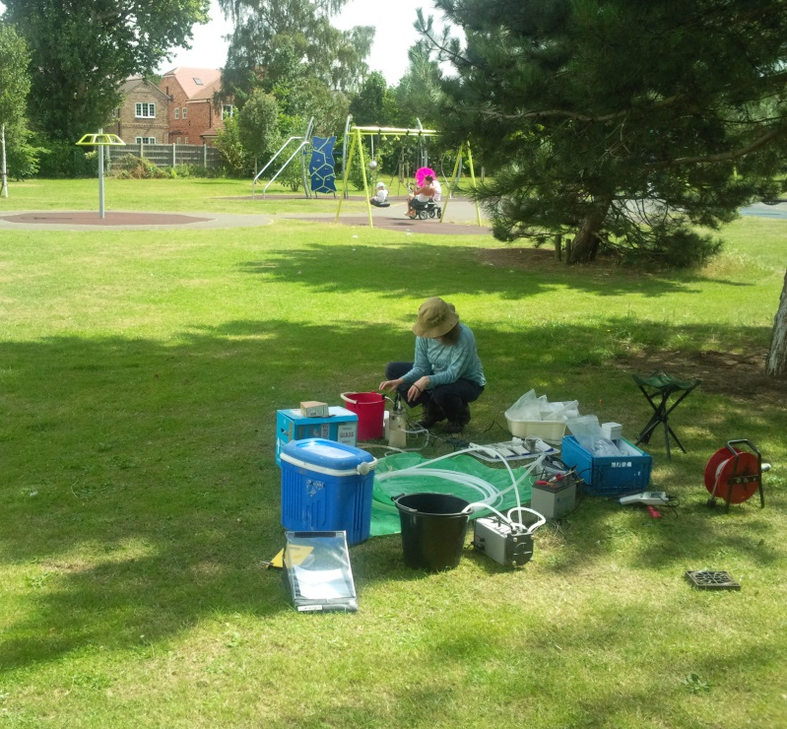
Sampling multilevel piezometers in Doncaster
Notes:
The AISUWRS multilevel piezometers were installed in selected parks and green spaces in Doncaster in 2003. The multilevels were constructed as a bundle of different length tubes installed into a drilled borehole. Each multilevel has 7 ports or separate tubes with the shallowest and deepest being constructed of PVC and the others 5 of HDPE tubing. Each port has 30cm screened sections and a cap at the bottom. All levels are hydraulically separated to stop leakage.
Inertial pumps with a powerpack were used to sample some of the ports during the project and these were left in the piezometers.
In February and July this year we returned to 3 of the Doncasters multilevels and sampled them for field chemistry, inorganic chemistry as well as the EA’s Emerging Contaminant Suite.
each multilevel was purged until the field parameters became stable before sampling.
Know construction, ML’s so good for profiling, geology.
Sandall Beat and HP 1 dissappeared over the intervening 1- years

Slide 14
Doncaster B and MO profiles
Boron historical wastewater indicator
Concentrations have declined with time
MOs show similar shape
Penetration to
50 m
More compounds during high water levels in July
Notes:
Boron shows consistent profile over time
Numbers of MOs appear to be related

Slide 15
Nottingham Cl and MO profiles
Chloride profile similar over 10 years
Possible evidence of Cl at depth
ECs again show similar shape
From MSc project work by Stephanie Allcock and Nicola Moorhead
Notes:
Ditto chloride in Nottingham
Not our data but comes from series of student experiments at Birmingham U

Slide 16
Nottingham MO concentration profile
Left profile shows uncorrected concentrations
Right profile shows blanks!
Predominantly industrial compounds and plasticisers
Notes:
Very different pattern if we look at concentrations
Huge peak of 2-propanol 1-chloro phosphate (1:3) at 18 m flame retardant/plasticiser
NBBS in the blank
Also demonstrates how carefully blanks need to be collected.

Slide 17
Summary of compounds found
Industrial compounds (24): 1-(2,3-dihydro-1H-inden-5-yl) ethanone, 1,3-dichlorobenzene, 1(3H)-isobenzofuranone, 1,4-dioxane, 2-benzoylbenzoic acid methyl ester, 2-chlorophenyl isocyanate, 2-propanol, 1-chloro phosphate (3:1), 2,4-dimethyl phenol, 2,4-di-tert-butylphenol, 3,5-dimethylphenol, 3,5-di-tert-butyl-4-hydroxyacetophenone, benzothiazole, bisphenol A, dibromomethane, cyclohexanone, furfural, isopropyl benzene, n-propyl benzene, o-phenyl phenol, styrene, triacetin, trichloroethene, tetrachloroethene
Plasticisers and UV stabilisers(10): (1-hydroxycyclohexyl) phenyl methanone, 2,6-di-tert-butylphenol, 7,9-di-tert-butyl-1-oxaspiro(4,5)deca-6,9-diene-2,8-dione, benzophenone, bis(2-ethyl hexyl) adipate, DEHP, DEP, DMP, BBSA, octabenzone
PCPs (4): benzyl benzoate, DEET, ethyl paraben, octocrylene
Pesticides (4): atrazine, BAM, desethyl atrazine, simazine
Petroleum-related (3): indane, indene, naphthalene
Nottingham, Doncaster, Both

Slide 18
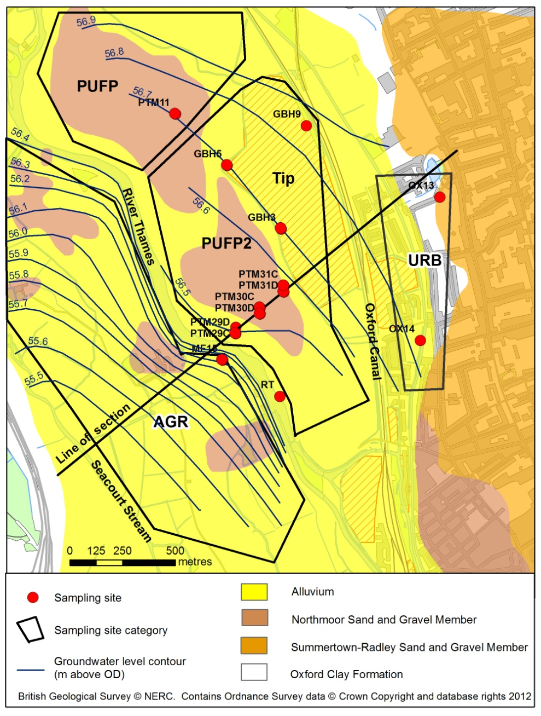
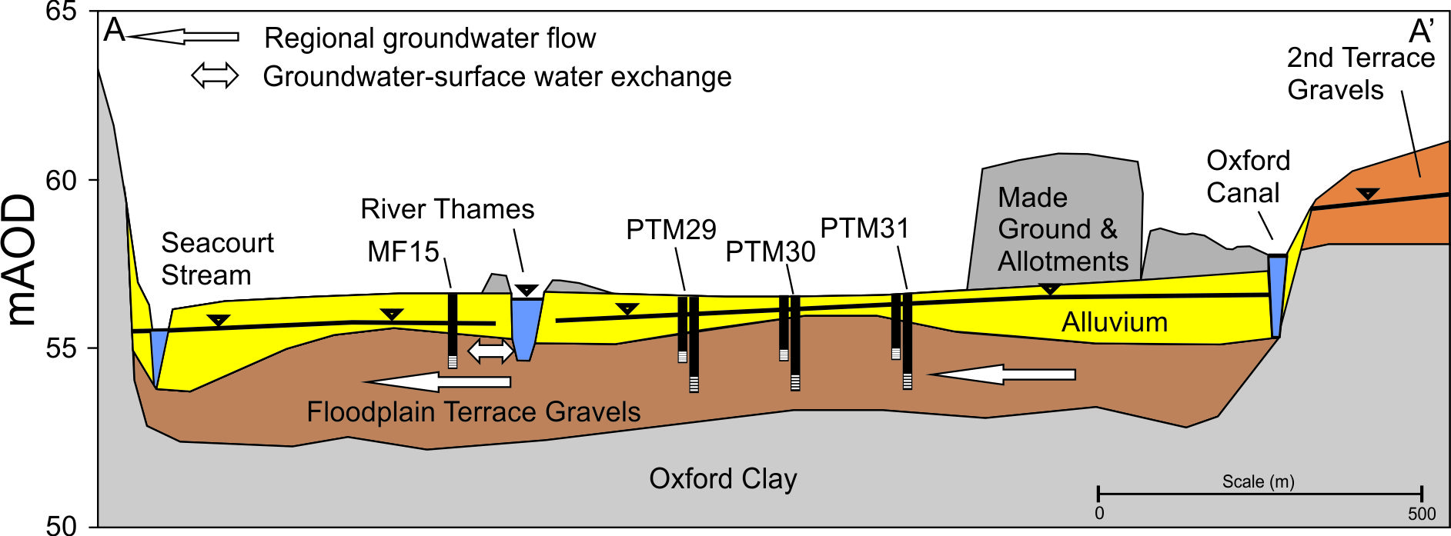
Oxford Portmeadow
Contrasting setting on shallow Thames floodplain gravels
Areas:
  Urban
  Landfill
  Landfill plume
  Agricultural
  Thames

Slide 19
Fingerprinting groundwater
Concentration and species clearly delineate landuse in the floodplain
Can be used as tracers for catchment pathways and groundwater/surface water interaction

Slide 20
Portmeadow seasonal behaviour
Two sampling campaigns
Major compounds similar detection frquency
Many with only one detection
Notes:
Explain seasonal behaviour eg water levels

Slide 21
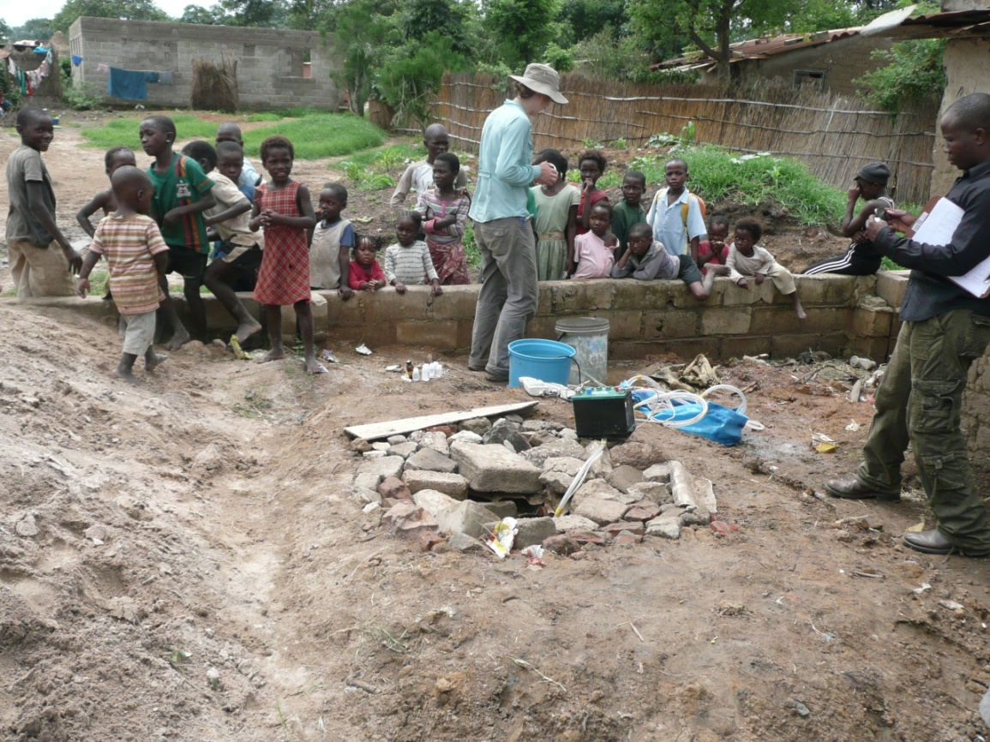
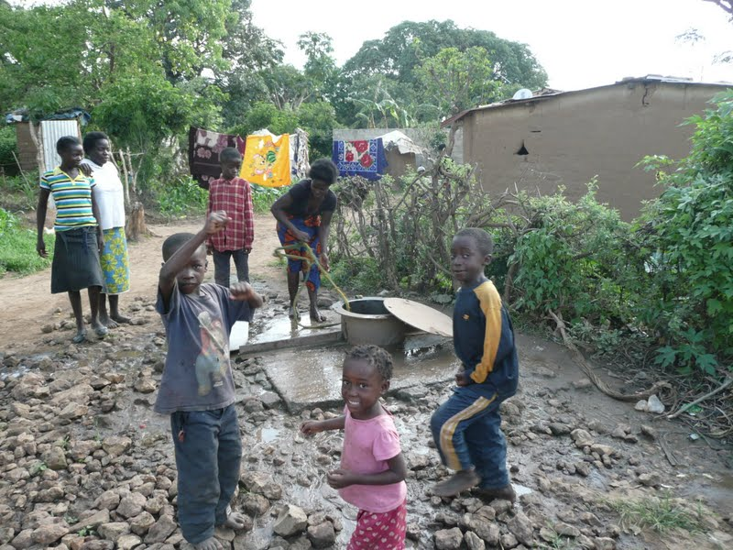

Kabwe, Zambia
Shallow aquifer in weathered basement
Samples from supply wells and boreholes
Routes to groundwater from poor well completion
Sources – on-site sanitation
Notes:
Very different setting here. Lower picture shows completely unprotected well

Slide 22
Kabwe, sample sites

Slide 23
Kabwe
Microorganics in groundwater most frequent in:
  Wells
  Low cost housing areas
  Generally in the wet season

Slide 24
Kabwe, key compounds
PCPs and THMs in dry season in high cost housing only

Slide 25
Sources of microorganics in urban areas
The sampling process
  Always be aware of composition of infrastructure i.e. plastic piezometers
  The sampler
  Collect meaningful blanks
Sewer leakage and other wastewater
  PCPs, caffeine and surfactants
Other sources
  Industrial discharges
  Possible amenity pesticide use in UK
  Petroleum compounds
  Road run off

Slide 26
Are emerging contaminants in groundwater important?
An increasing range of compounds is being detected
Some are probably no threat to drinking water at such µg/L concentrations, e.g. caffeine
Others may prove to be in the future
Urban areas show impact of sewage and industrial wastewater
We may see increasing PCPs and industrial chemicals as counties develop.
There is little information on their impact on other groundwater receptors in the environment

